Slide 1
Home page / Landing Page

Slide 2
Place a password

Slide 3
Put a password on the site so nobody can see our progress
Password: Progress
You could always place a coming soon page there and time it for 2-3 months?
We just need to change the picture and logo.
See example
http://preview.themeforest.net/item/brainbizz-finance-business-wordpress-theme/full_screen_preview/22835404?_ga=2.50342250.258836864.1624524424-1952668530.1593696106

Slide 4
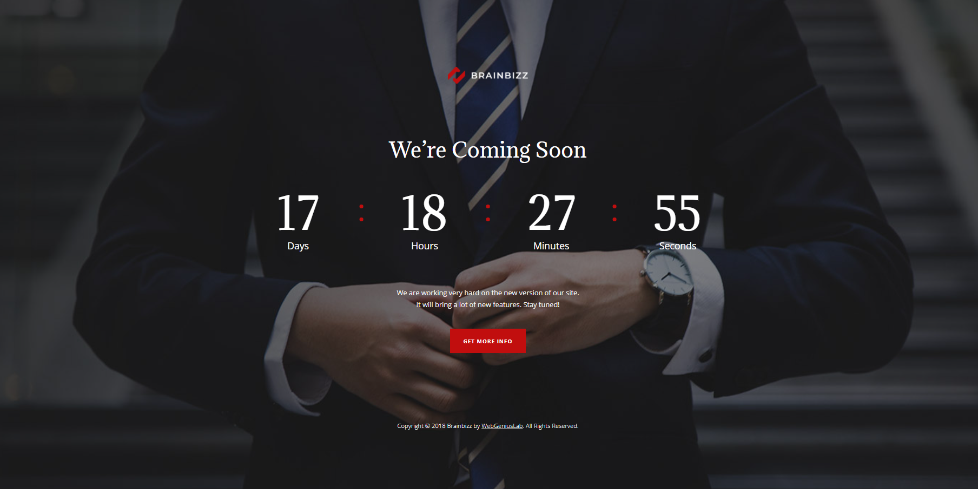

Slide 5
Landing Page

Slide 6
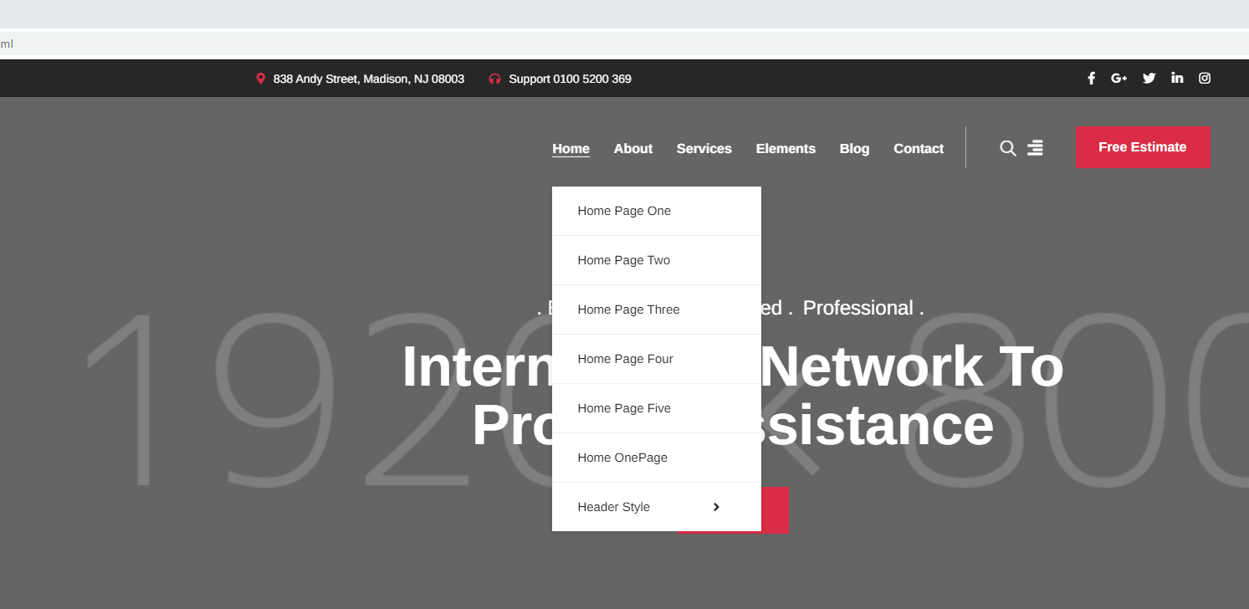
Using the template this is the menus ill refer to.

Slide 7
Header Style / Top Menu

Slide 8

Insert this from homepage , header style 4

Slide 10
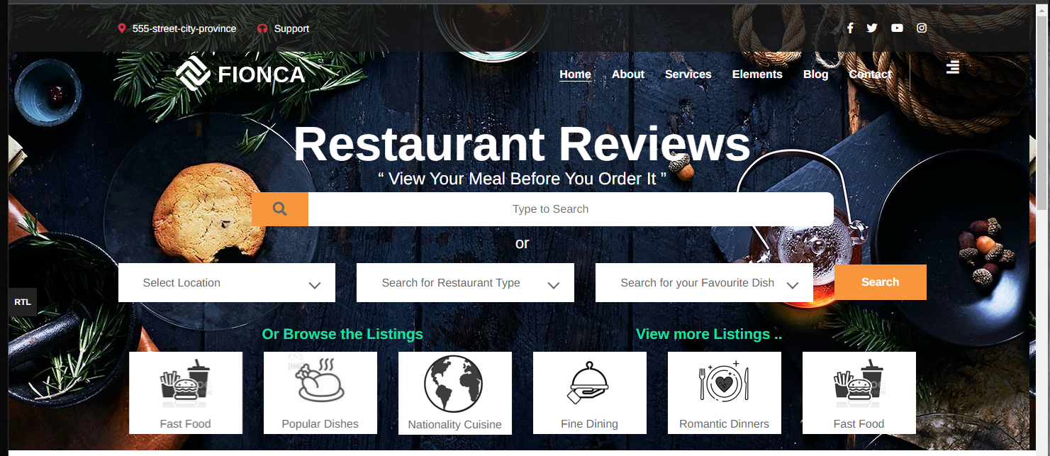
Rename and Have these 4 top menus
About
Post A Review
Register Your Venue
Services
Support / Contact

Slide 11
So it should look like this
About
Post A Review
Register Your Venue
Support / Contact

Slide 12
Remove these menus

Slide 13
Remove These
About
Post A Review
Register Your Venue
Support / Contact

Slide 14
Should look like this
About
Post A Review
Register Your Venue
Support / Contact

Slide 15
Remove template logo

Slide 16
Remove the template menu
About
Post A Review
Register Your Venue
Support / Contact

Slide 17
Should look like this
About
Post A Review
Register Your Venue
Support / Contact

Slide 18
Move main Title
Top Main Title (Home Button)

Slide 19
Move Restaurant Reviews title Here
About
Post A Review
Register Your Venue
Support / Contact

Slide 20
Should look like this
Restaurant Reviews
About
Post A Review
Register Your Venue
Support / Contact

Slide 21
Insert Icon
Next to title

Slide 22

Insert the Icon next to the title - For now just place an orange circle
Restaurant Reviews
About
Post A Review
Register Your Venue
Support / Contact

Slide 24
Insert Background

Slide 25
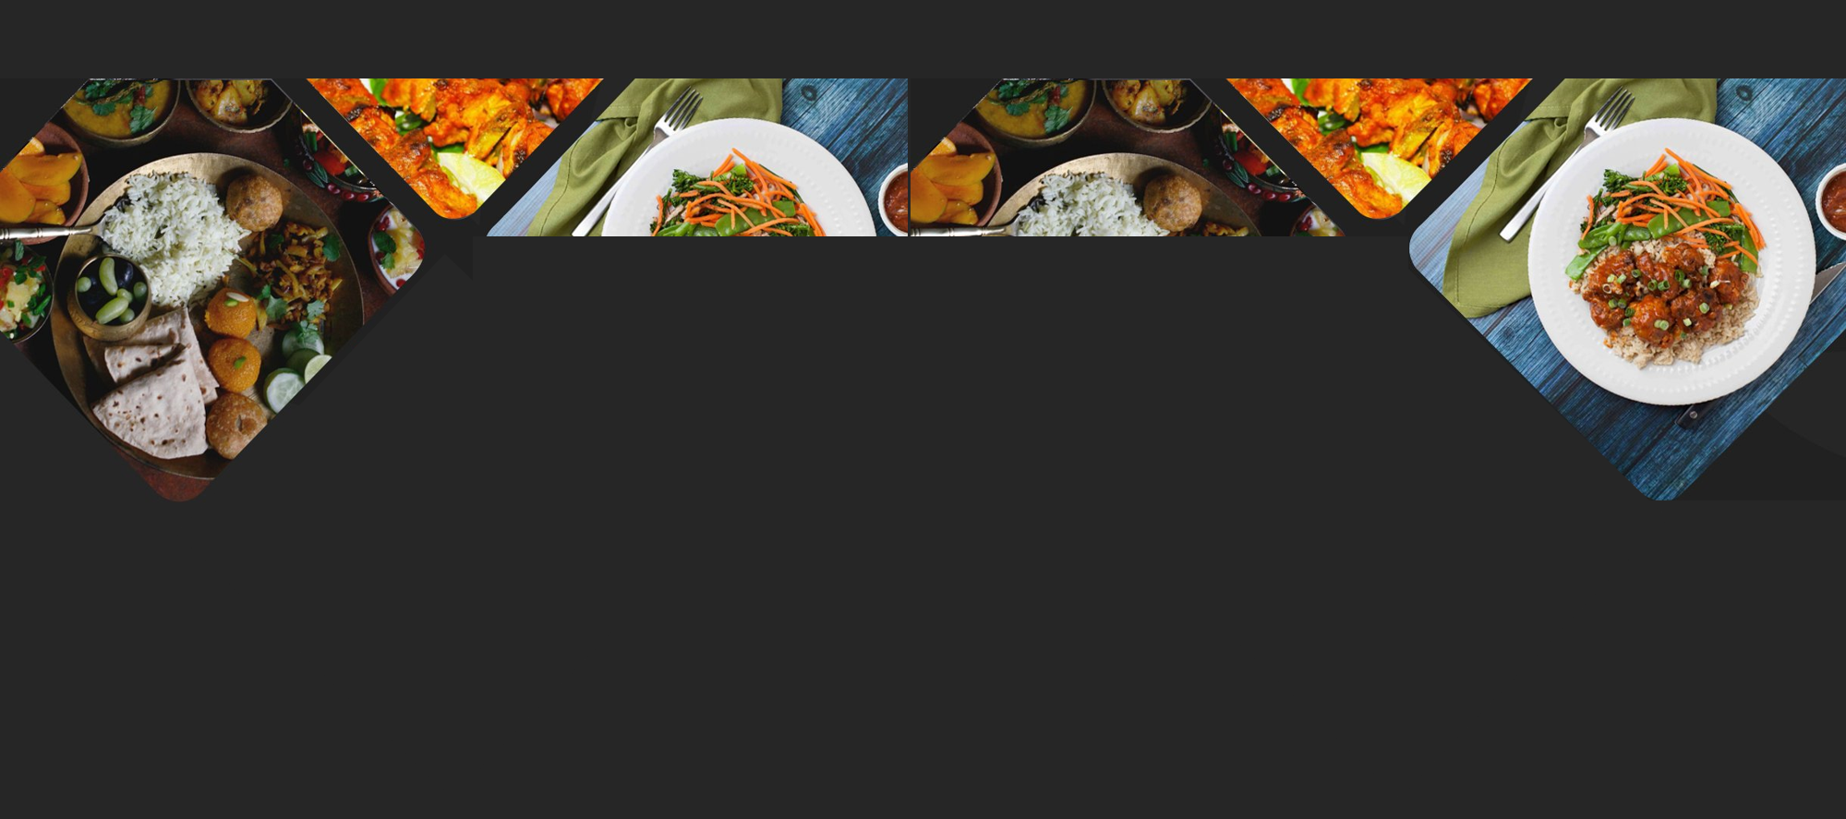
For Now just make the Background this picture temporary for now

Slide 26
Add Main Text

Slide 27
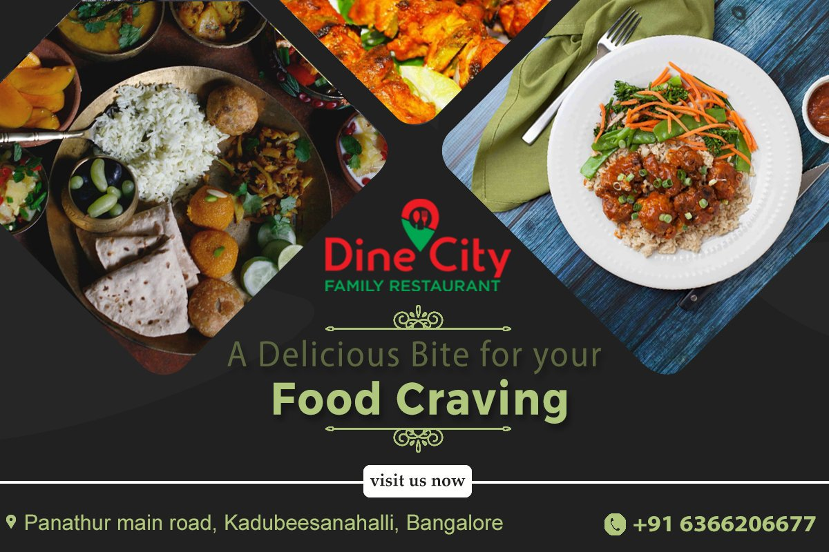
Insert the Text as shown - With Same Spacing
Restaurant Reviews
“ View Your Meal Before You Order It ”

Slide 28
Add altered Search features
As shown

Slide 29

Insert the Text as shown - With Same Spacing
Restaurant Reviews
“ View Your Meal Before You Order It ”
Search For Desired Restaurant Name ……… OR
Search Restaurant Location
Search Radis
15Km
Search For Restaurant Type
Todays Local Specials
Search For Your Favourite Dish
Search

Slide 30
Landing Page

Slide 31
Search Fields Explained

Slide 32
Search Feature Highlight

Slide 33
When a field is selected make it highlighted with an outline and the cursor flashing so they know to type
Restaurant Reviews
“ View Your Meal Before You Order It ”
I Search For Desired Restaurant Name ……… OR
Search Restaurant Location
Search Radis
15Km
Search For Restaurant Type
Flashing text symbol
Todays Local Specials
Search For Your Favourite Dish
Search

Slide 34
When a field is selected the other fields will change colour to show that they are not currently important
Restaurant Reviews
“ View Your Meal Before You Order It ”
Search For Desired Restaurant Name ……… OR
Search Restaurant Location
Search Radis
15Km
Other text boxes change colour to show that they are not selected
Search For Restaurant Type
Todays Local Specials
Search For Your Favourite Dish
Search

Slide 35
Restaurant Name

Slide 36
Insert the Text as shown - With Same Spacing
Restaurant Reviews
“ View Your Meal Before You Order It ”
Search For Desired Restaurant Name ……… OR
Search Restaurant Location
Search Radis
15Km
Search For Restaurant Type
Todays Local Specials
Search For Your Favourite Dish
Search

Slide 37
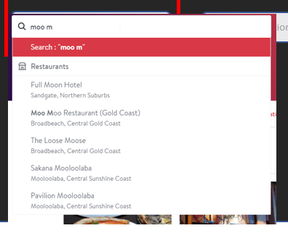
This will search our list of restaurants that we have stored in the database that we will build.
Must use predictive text to make it easier for clients to use.
When its being used it will use a predictive text to help find the restaurant from our list of restaurants.
The drop down will look like this and will cover the other fields

Slide 38
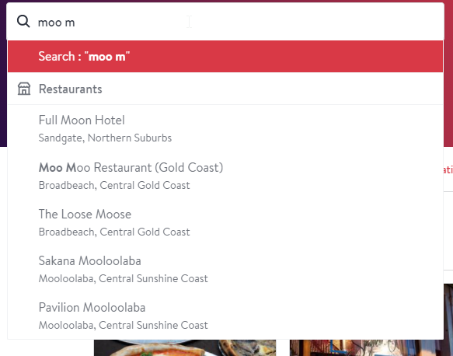
Example of search bar
https://www.opentable.com.au/

Slide 39
Search Restaurant Location

Slide 40
Insert the Text as shown - With Same Spacing
Restaurant Reviews
“ View Your Meal Before You Order It ”
Search For Desired Restaurant Name ……… OR
Search Restaurant Location
Search Radis
15Km
Search For Restaurant Type
Todays Local Specials
Search For Your Favourite Dish
Search

Slide 41
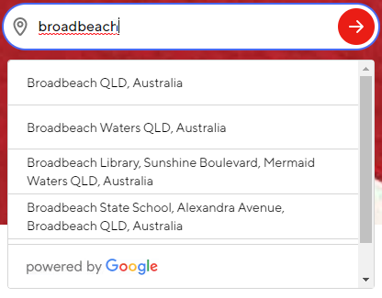
I'm after ideas here on how we can display the search box by location.
I'm sure there is a WordPress theme that we could use that will use predictive text to find a town.
Its also important that we have a Radis search so they can select to display restaurants in a Radis that they can select.
Example
https://www.doordash.com/
Important
If they click on a name its then moved to the search box

Slide 42
When a town is selected it saves it in the search box. This should be saved for future searches.

Slide 43
Database (project 2)
It will need to display the database of restaurants in the defined area.
Using a template that ill provide.

Slide 44
Have it so they can select from 5km, 10km, 15km, 20km, 25km, 30km, 35km, 40km, 45km , 50km range
Restaurant Reviews
“ View Your Meal Before You Order It ”
Search For Desired Restaurant Name ……… OR
Search Restaurant Location
Search Radis
15Km
Search For Restaurant Type
Todays Local Specials
Search For Your Favourite Dish
Search

Slide 45
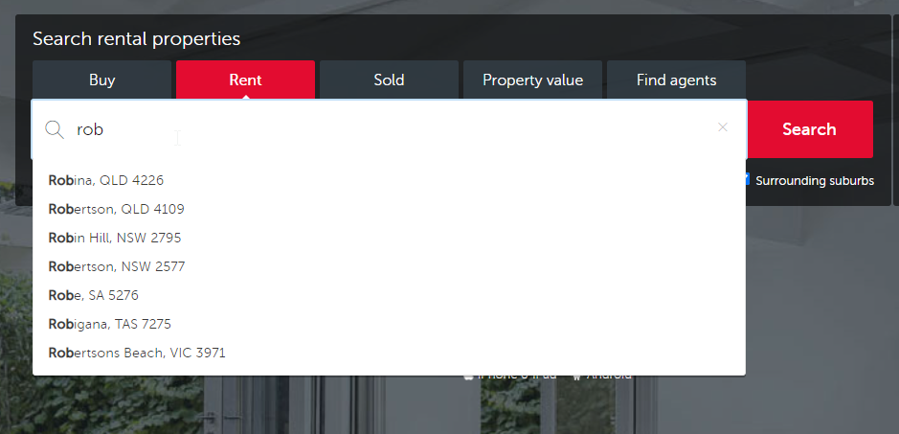
Another Example
https://www.realestate.com.au/rent/

Slide 46
Database (project 2)
It will need to display the database of restaurants in the defined area.
Using a template that ill provide.

Slide 47
Search Restaurant Type

Slide 48
This will be a dropdown menu that displays a list of restaurant types
Restaurant Reviews
“ View Your Meal Before You Order It ”
Search For Desired Restaurant Name ……… OR
Search Restaurant Location
Search Radis
15Km
Search For Restaurant Type
Todays Local Specials
Search For Your Favourite Dish
Search

Slide 49
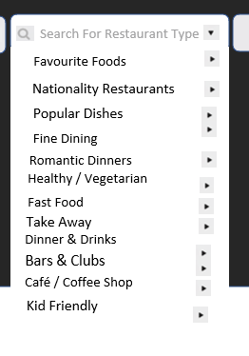
When they click on Restaurant Type this is the drop down menu that needs to be displayed

Slide 50
Database (project 2)
It will need to display the database of restaurants in the defined area.
Using a template that ill provide.

Slide 51
If they were to select a category such as “Favourite Foods” then the Favourites Foods title will appear in the Box
Restaurant Reviews
“ View Your Meal Before You Order It ”
Search For Desired Restaurant Name ……… OR
Search Restaurant Location
Search Radis
15Km
Search For Restaurant Type
Favourite Foods
Todays Local Specials
Search For Your Favourite Dish
Search

Slide 52
Grid Menus

Slide 53
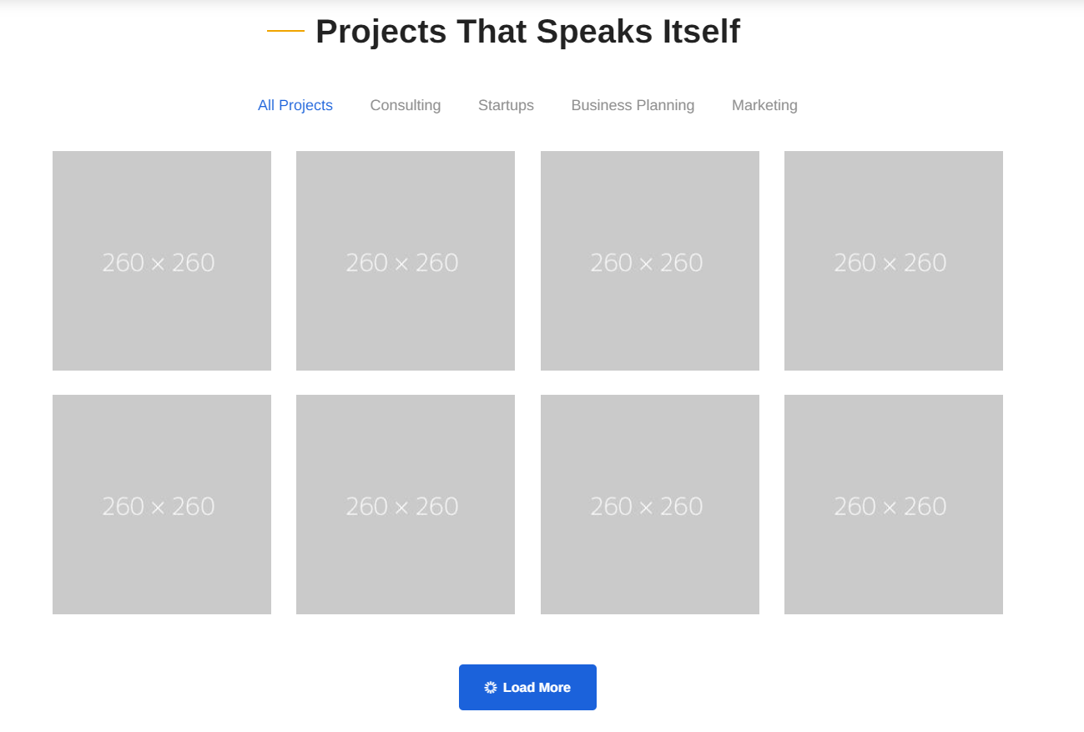
Landing Page 4
Take this section of the example of the 4th landing page and make it so the tiles fore each category are represented.
Make it 6 X 2 in the Black and red icons that have been created.

Slide 54
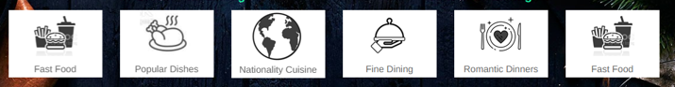
Example

Slide 55
We will focus on these grids later But for now just have mock ups

Slide 56
Under main search fields theses are the text templates that are required

Slide 57
Video Intro

Slide 58
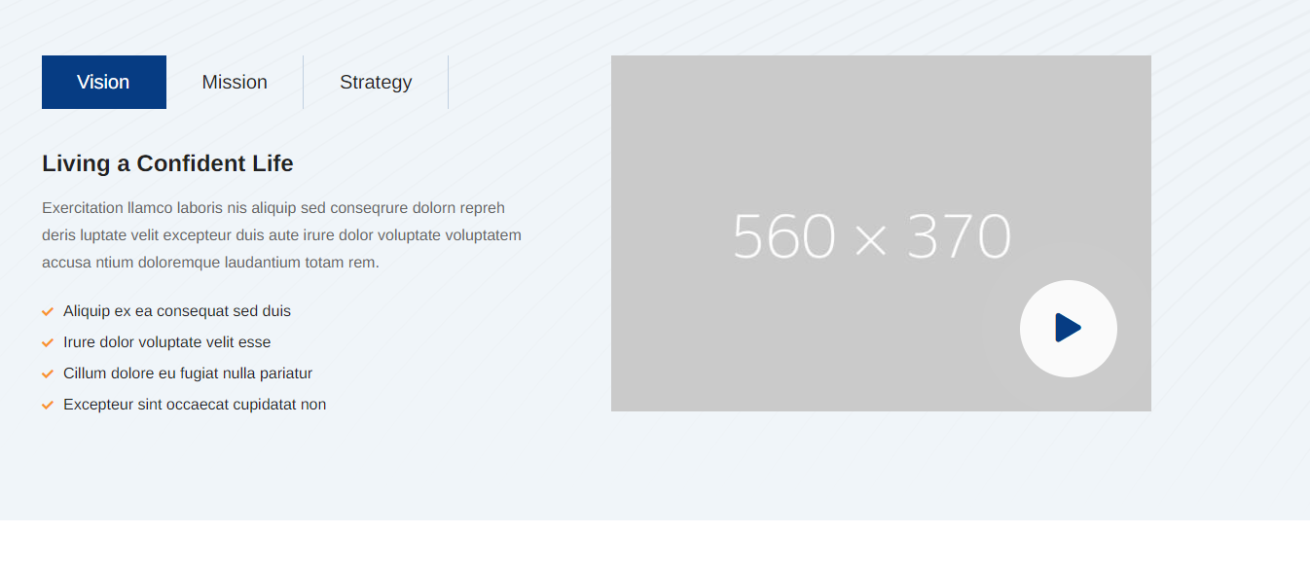

Slide 59
Products & Services

Slide 60

Insert this from homepage 2

Slide 61
Testermonials

Slide 62
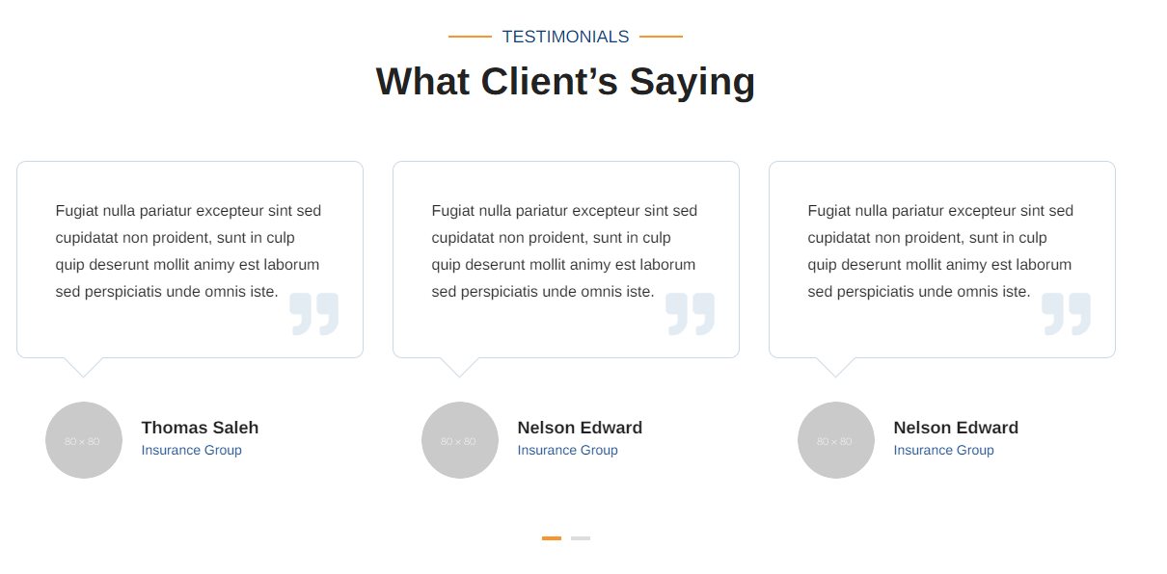
Insert this from homepage 1 (testimonial 3 from elements)

Slide 63
Map & Stats

Slide 64
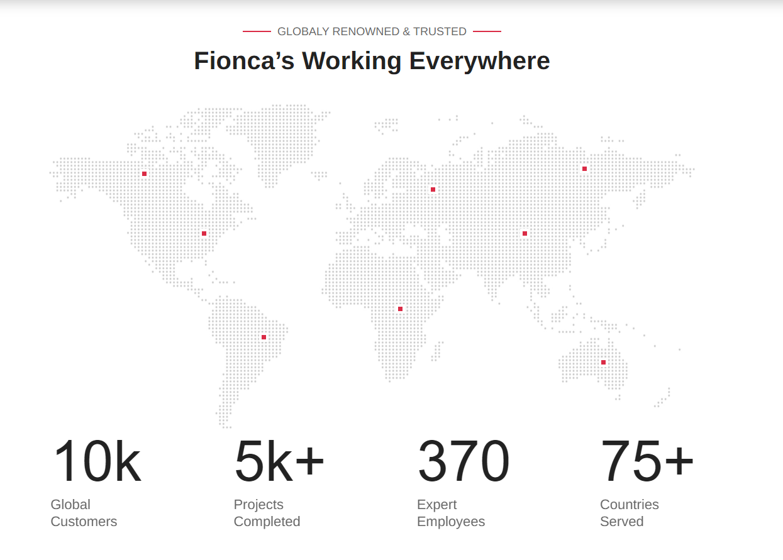

Slide 65
Add contact us section

Slide 66
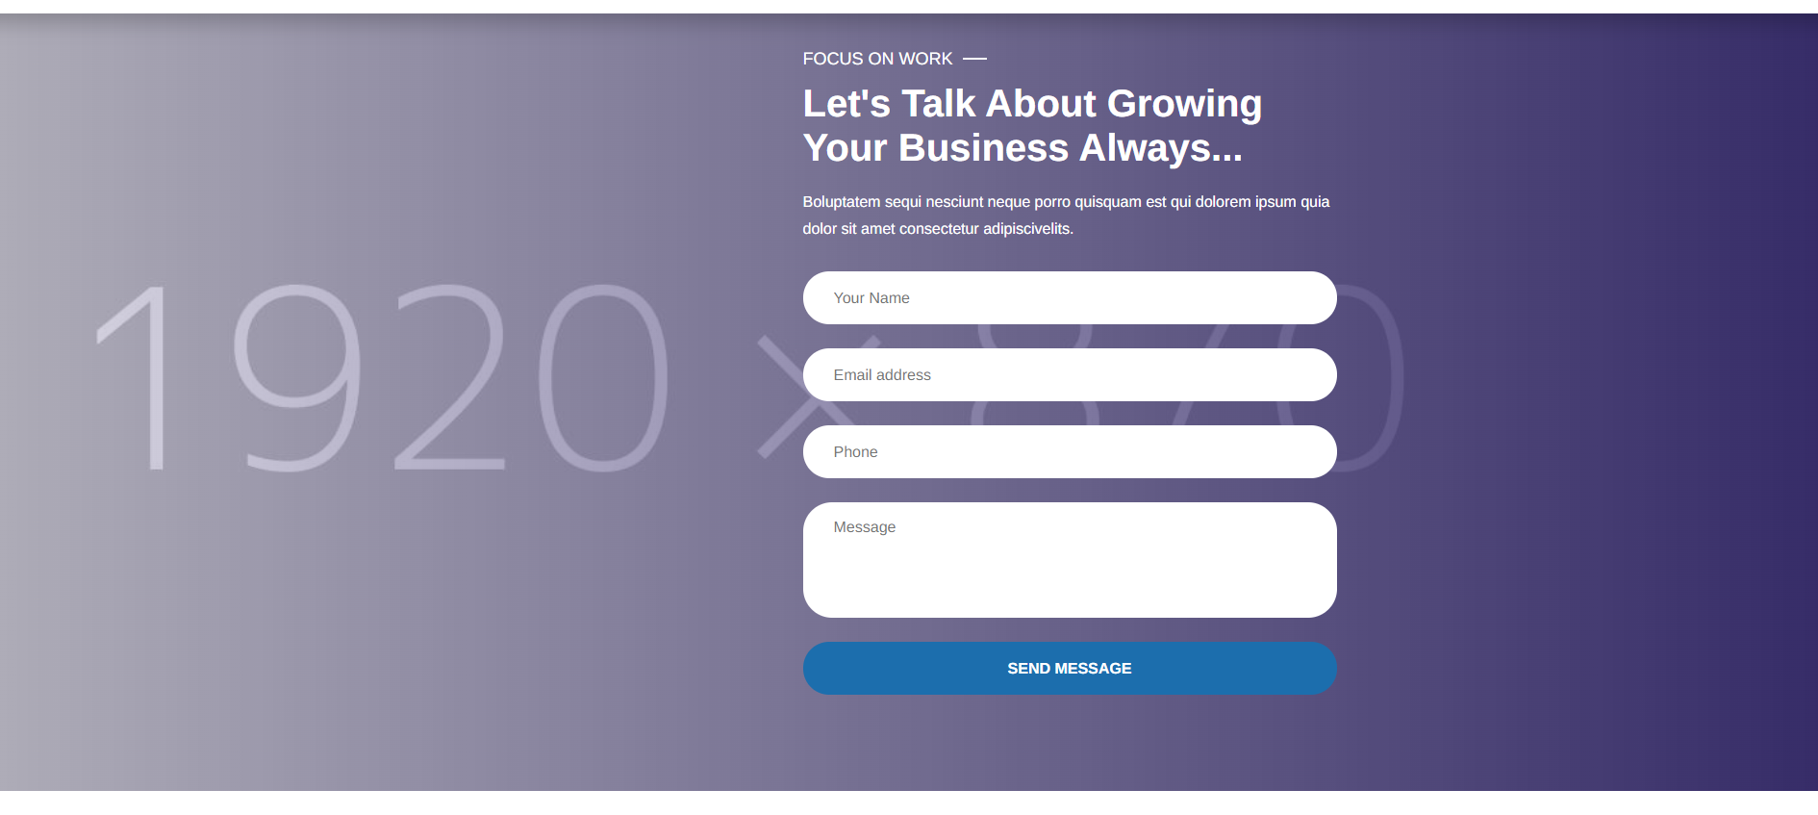
Insert this from homepage 3 and edit it like what's seen on the following slides

Slide 67
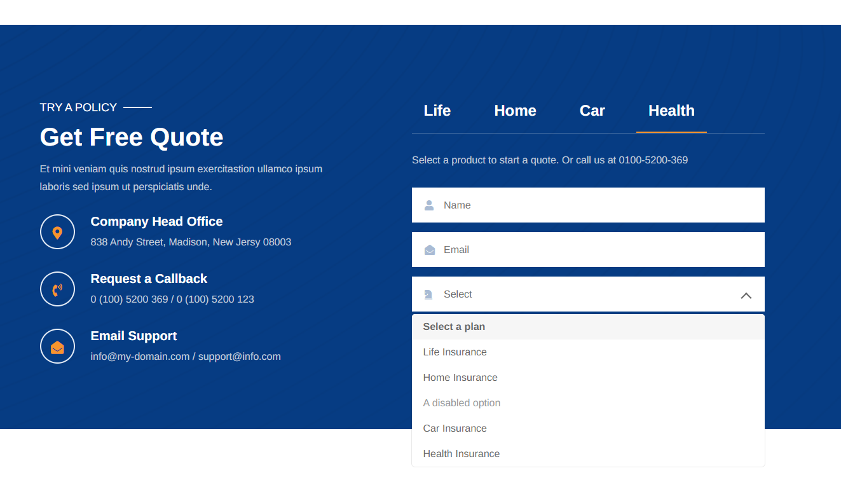
Add a contact us section that just has the following

Slide 68
The fields should include
Contact Name
Name of Restaurant / Venue (if required)
Email
Contact Number
Select Inquiry
Message

Slide 69
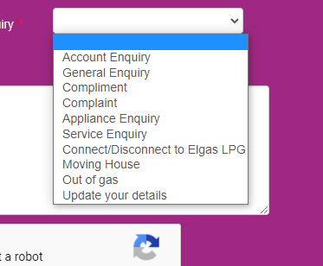
The Select Dropdown menus should include the following options
Register your Venue
Claim your existing venue listing
Technical assistance required
Posting a review
Marketing assistance inquiry
Upgrading your services
Compliments
Testimonials
Complaints
other.

Slide 70
Insert this from homepage 3 and edit it like what's seen on the following slides

Slide 71
Pricing Plans

Slide 72
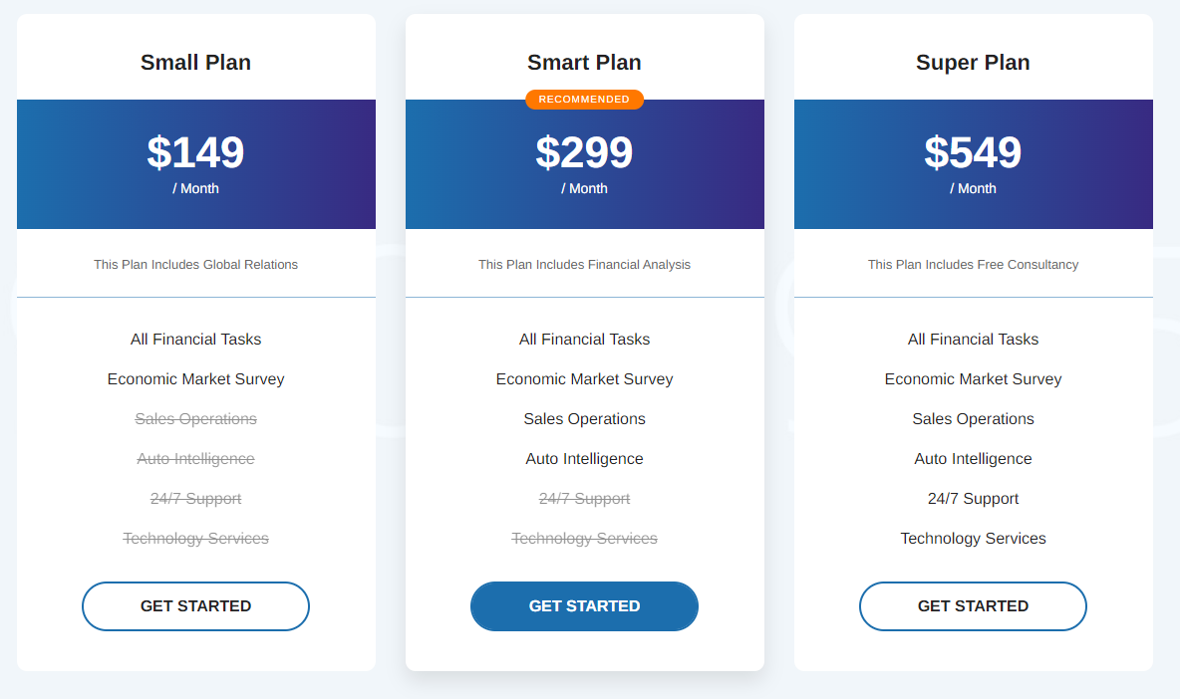

Slide 73
Our Affiliates

Slide 74
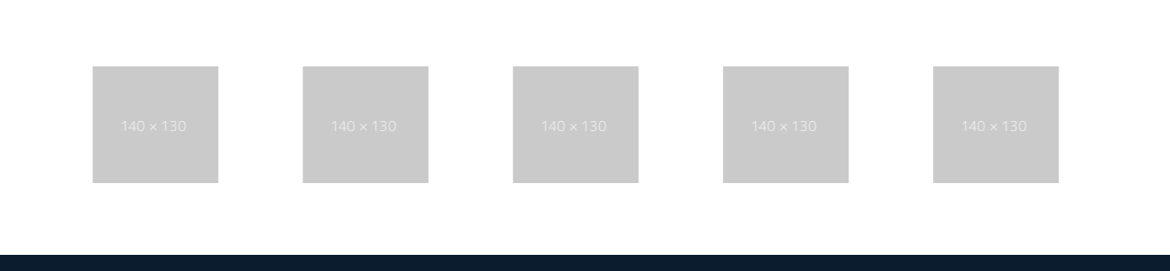
Insert the scrolling client list
Ill add the pictures

Slide 75
Footer

Slide 76
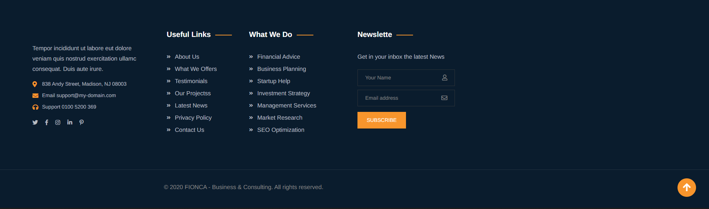
Insert this from homepage 2

